Slide 1
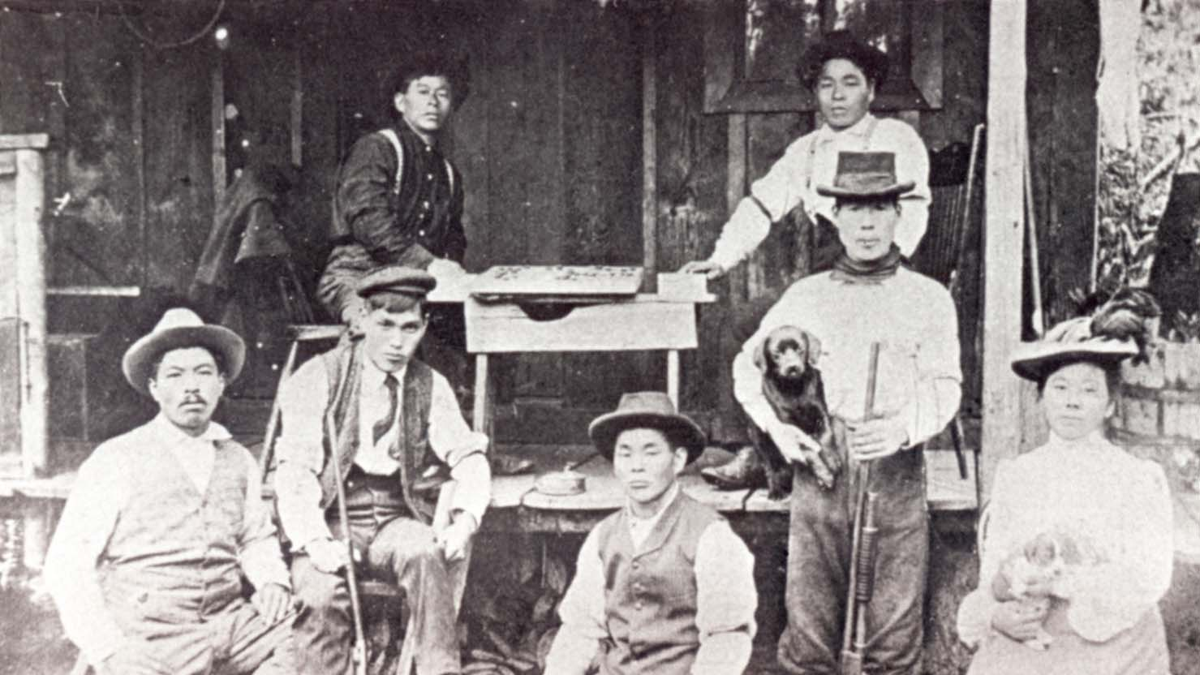


Japanese Americans before WWII
Dr. Zach Smith
Dept. of History | UCA
zsmith@uca.edu

Slide 2
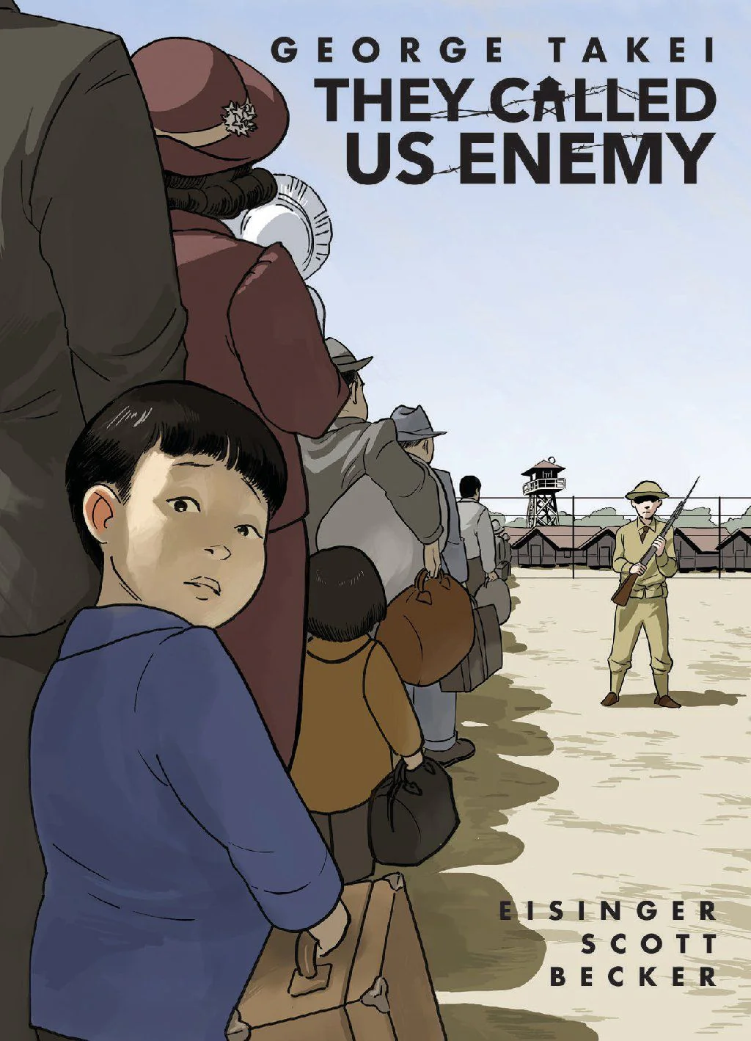
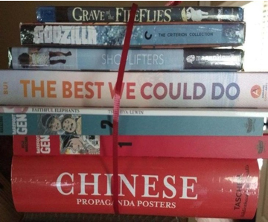
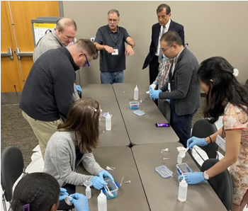
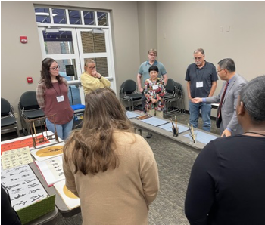
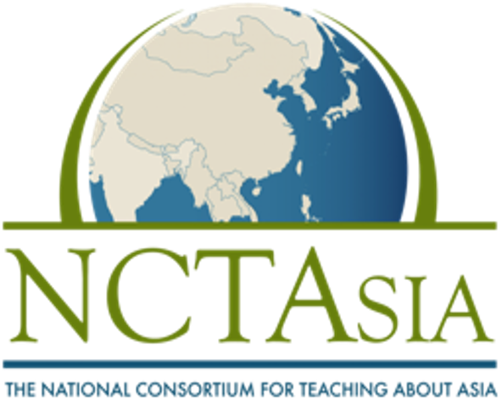
Arkansas NCTA
Founded in 1988 by the Freeman Foundation, the National Consortium for Teaching about Asia (NCTA) is an initiative to encourage and facilitate teaching and learning about East Asia in elementary and secondary schools across the United States.
For More Info
https://www.arncta.com
https://www.facebook.com/ARNCTA
https://www.nctasia.org
Enjoy a free copy of
George Takei’s They Called Us Enemy
Courtesy of

Slide 3
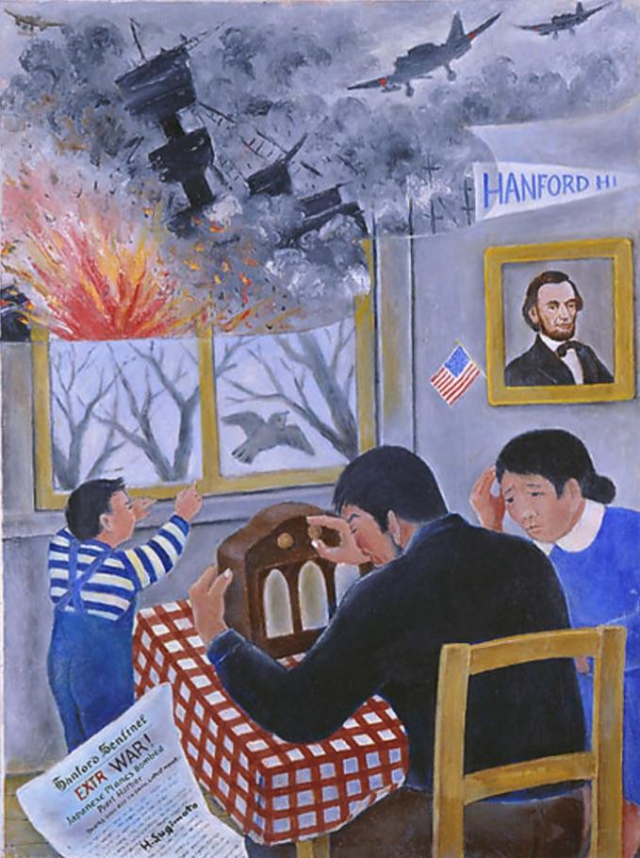
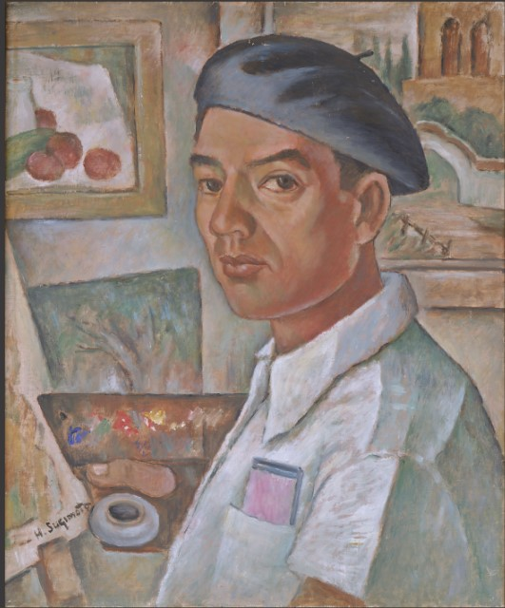
Henry Sugimoto
[1900 – 1990]
Born in Wakayama, Japan
Lived in Hanford, CA,
Imprisoned at Rohwer War Relocation Center
Painted over 100 oil paintings, later exhibited at Hendrix College in 1944
Henry Sugimoto, “News of Pearl Harbor,” oil on canvas, 1942 [Japanese American National Museum]

Slide 4
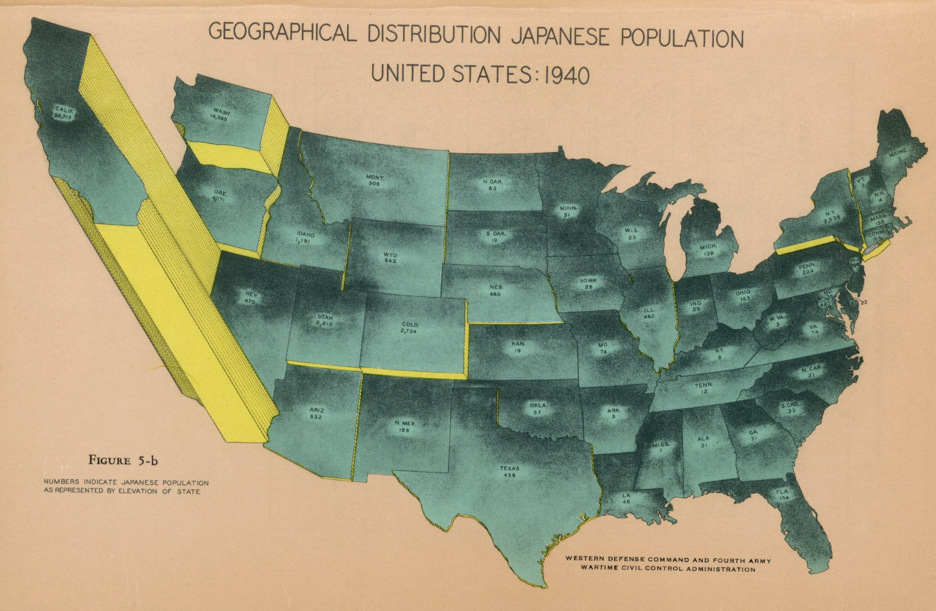
Geographic Distribution: Japanese Population, United States: 1940,” United States Office of War Information, the United States Army Western Defense Command and the Wartime Civil Control Administration, 1943

Slide 5
OUR QUESTIONS
What factors led Japanese nationals to immigrate to America in the late 19th and early 20th century?
How did American attitudes toward Japanese immigrants change over time?
How did popular images of the Japanese during WWII relate to earlier depictions?
Masabura Matsushima (seated, center) at a railroad camp in Oregon, c. 1895

Slide 6
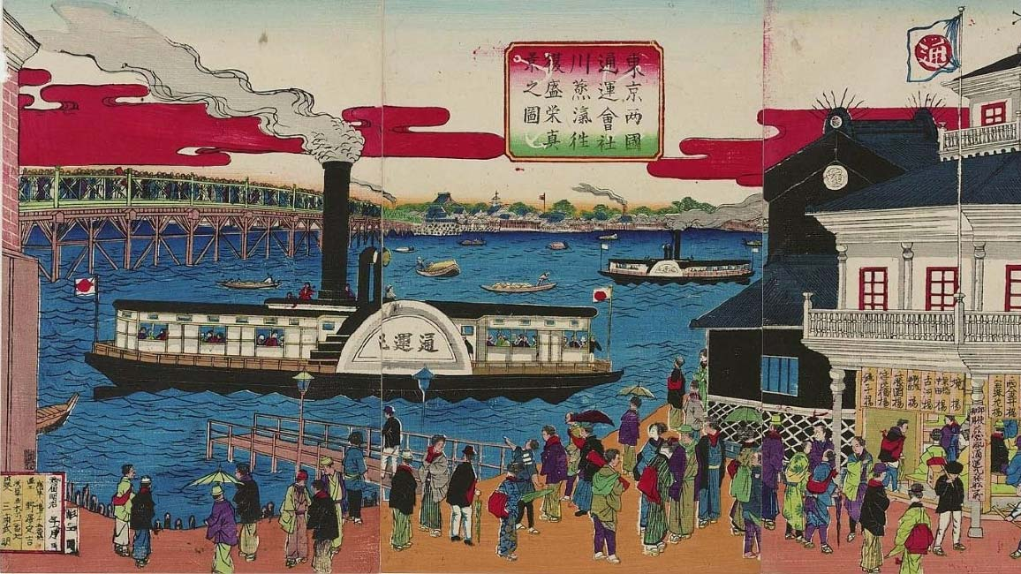
JAPAN in 1868:
The MEIJI RESTORATION leads to massive economic and political development
(+ massive social disruption), sparking a wave of emigration from Japan
Late 1800s:
Kokyo ni nishiki o kazaru
故郷に錦を飾る
“Return Home in Golden Brocades”

Slide 7
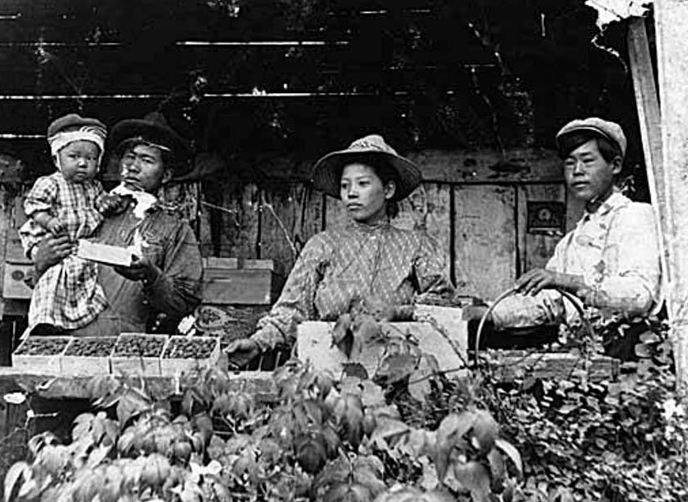
Japanese Population in the U.S.
C. 1910:
40,000 on farms
10,000 on railroads
4,000 in canneries
--
1,816 Japanese owned farms, totaling 99,254 acres
Matahichi and Kisa Iseri packaging berries on their farm in Sumner, Washington, 1908

Slide 8
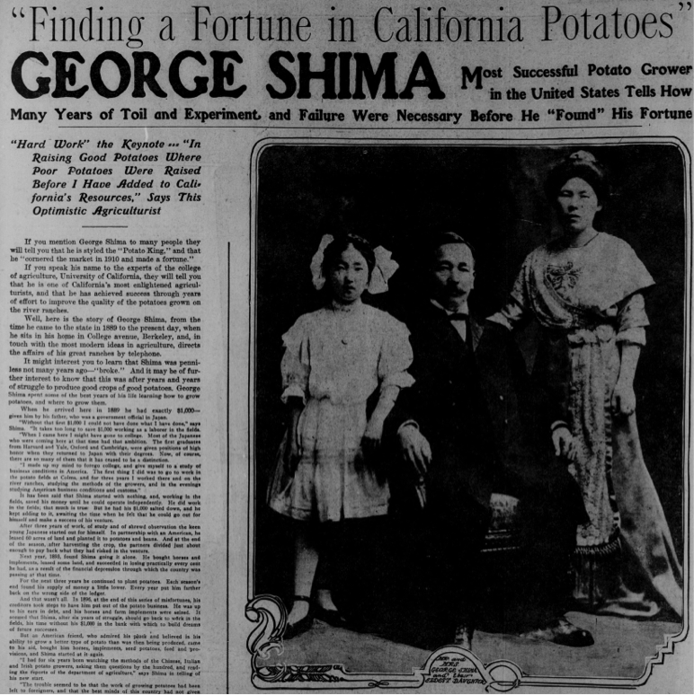
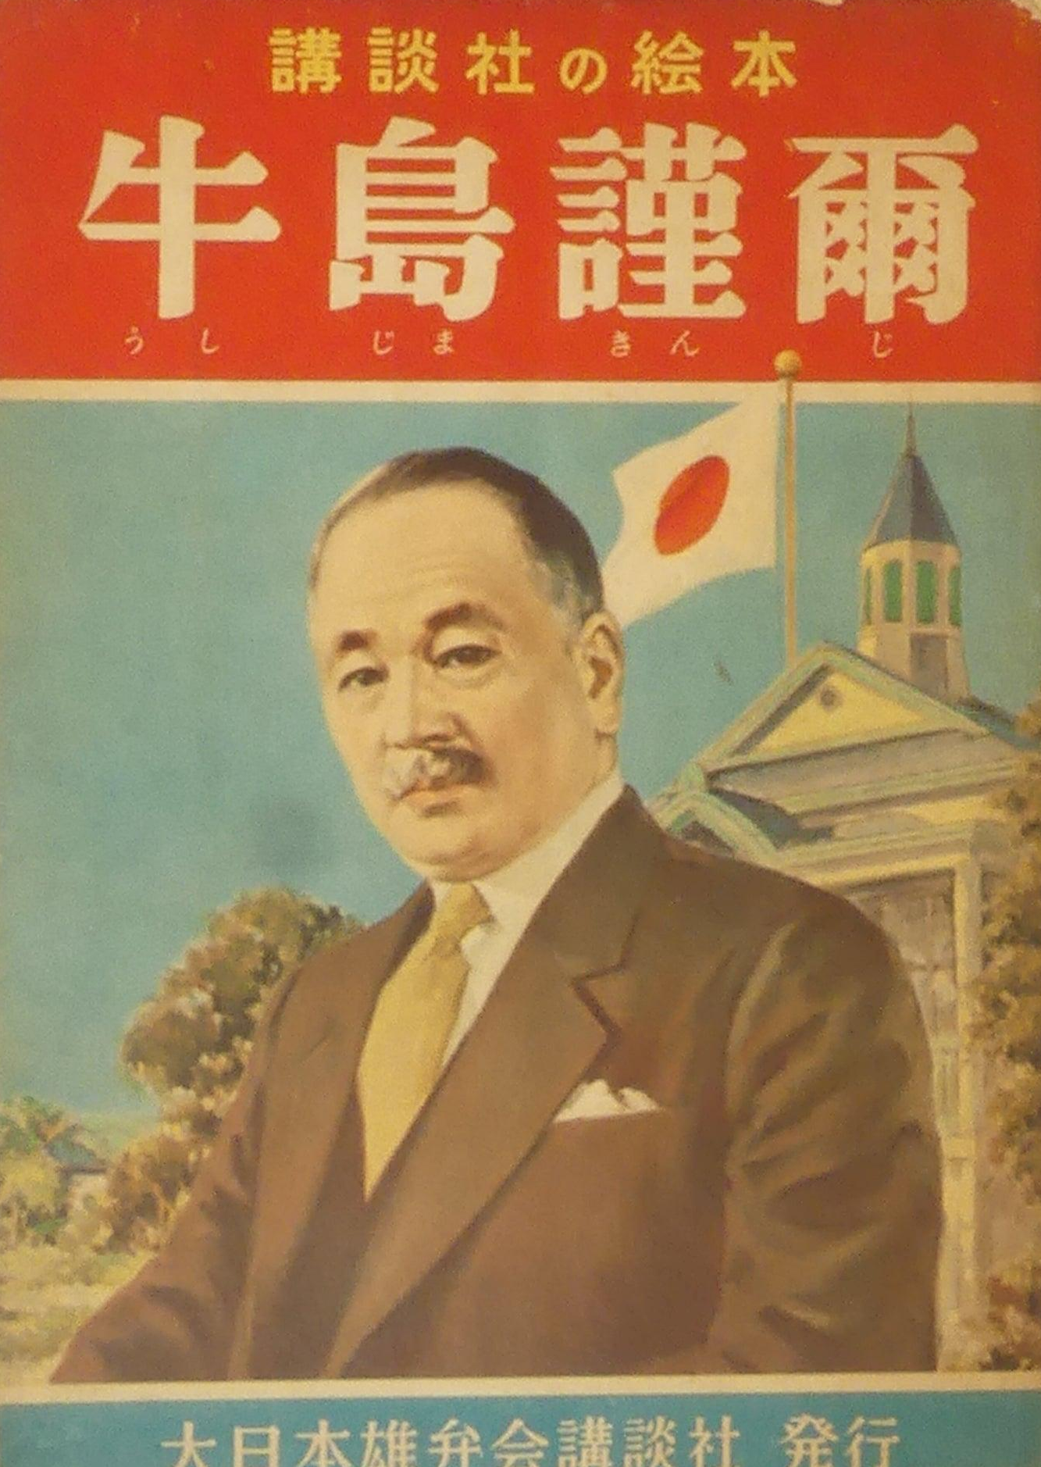
USHIJIMA KENJI
The POTATO KING of California
1887: Potato Picker in San Juaquin Valley
1920: 10,000 acres of potato farms, fleet of ships, multi-million $ estate
Illustrated Biography of Ushijima Kenji
牛島謹爾 [1950s]
San Francisco Call, March 10, 1912

Slide 9
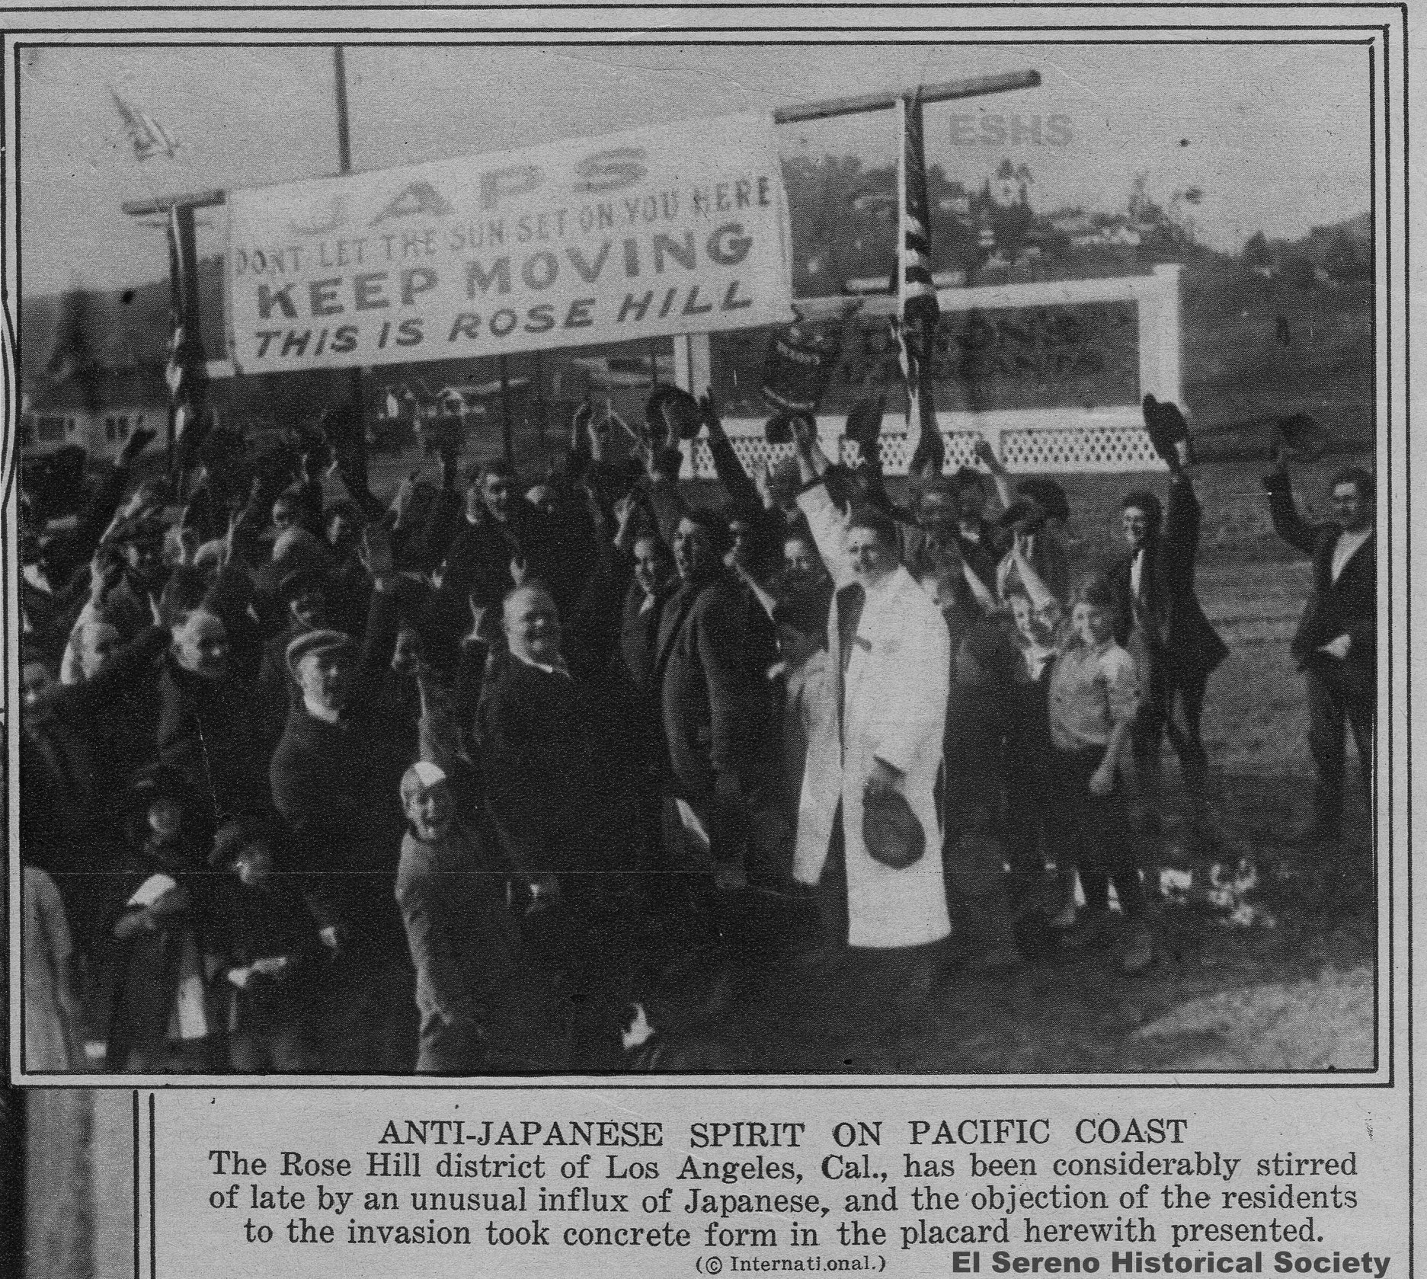
1907 Gentleman’s Agreement
Japan forbids further emigration to the United States & US agrees to not impose restrictions on immigrants already present
1913 Alien Land Law
Forbids “aliens ineligible for citizenship” from owning or leasing land
- Strengthened in 1920
- Superseded by …
Immigration Act of 1924
a.k.a. the Johnson-Reed Act
Total immigration quota of 165,000
Forbids “aliens ineligible for citizenship” from entering as immigrants at all
WHY?
Sign installed by the (all white) Rose Hill Civic Improvement Association (near Los Angeles), c. 1922

Slide 10
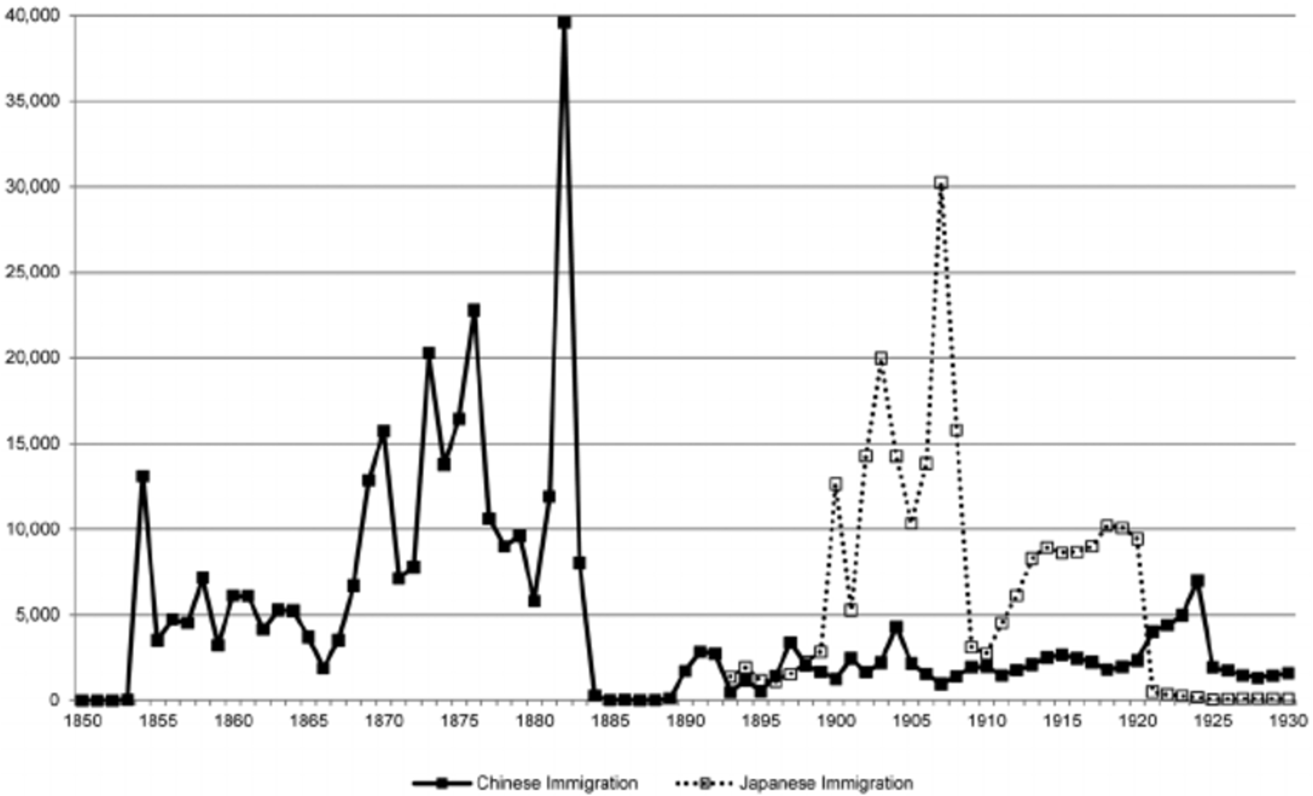
Chinese and Japanese Immigration to the US, 1850 - 1930
The “Gentleman’s Agreement” of 1907
The Johnson - Reed Act of 1924
Chinese Exclusion Act of 1882
Data: US Dept of Labor, 1930

Slide 11
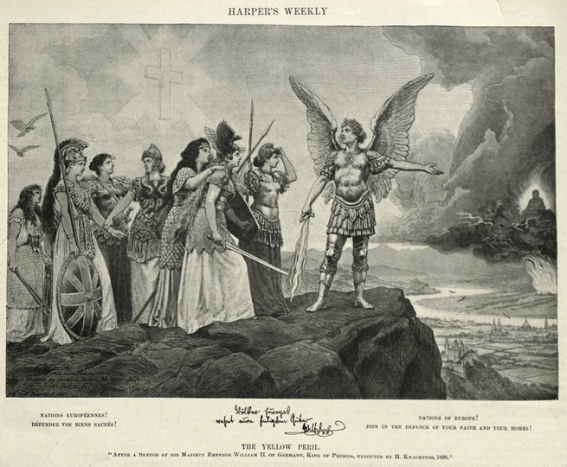
YELLOW PERIL
A racist color-metaphor propagating the assumption that people of Asian descent pose a threat to the “West”
The original 1895 “Yellow Peril” Lithograph by German artist Hermann Knackfuss, Harper’s Weekly Jan 22, 1898

Slide 12
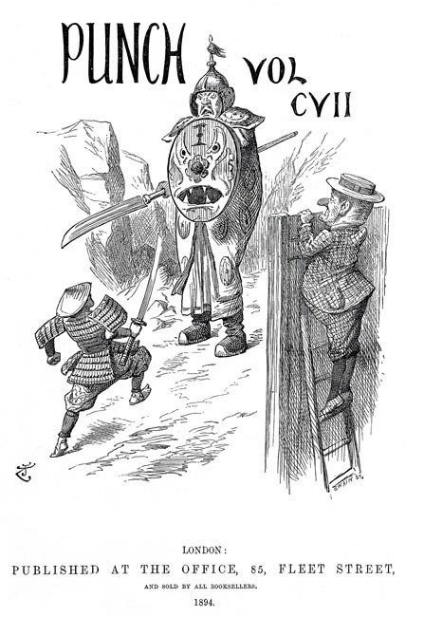
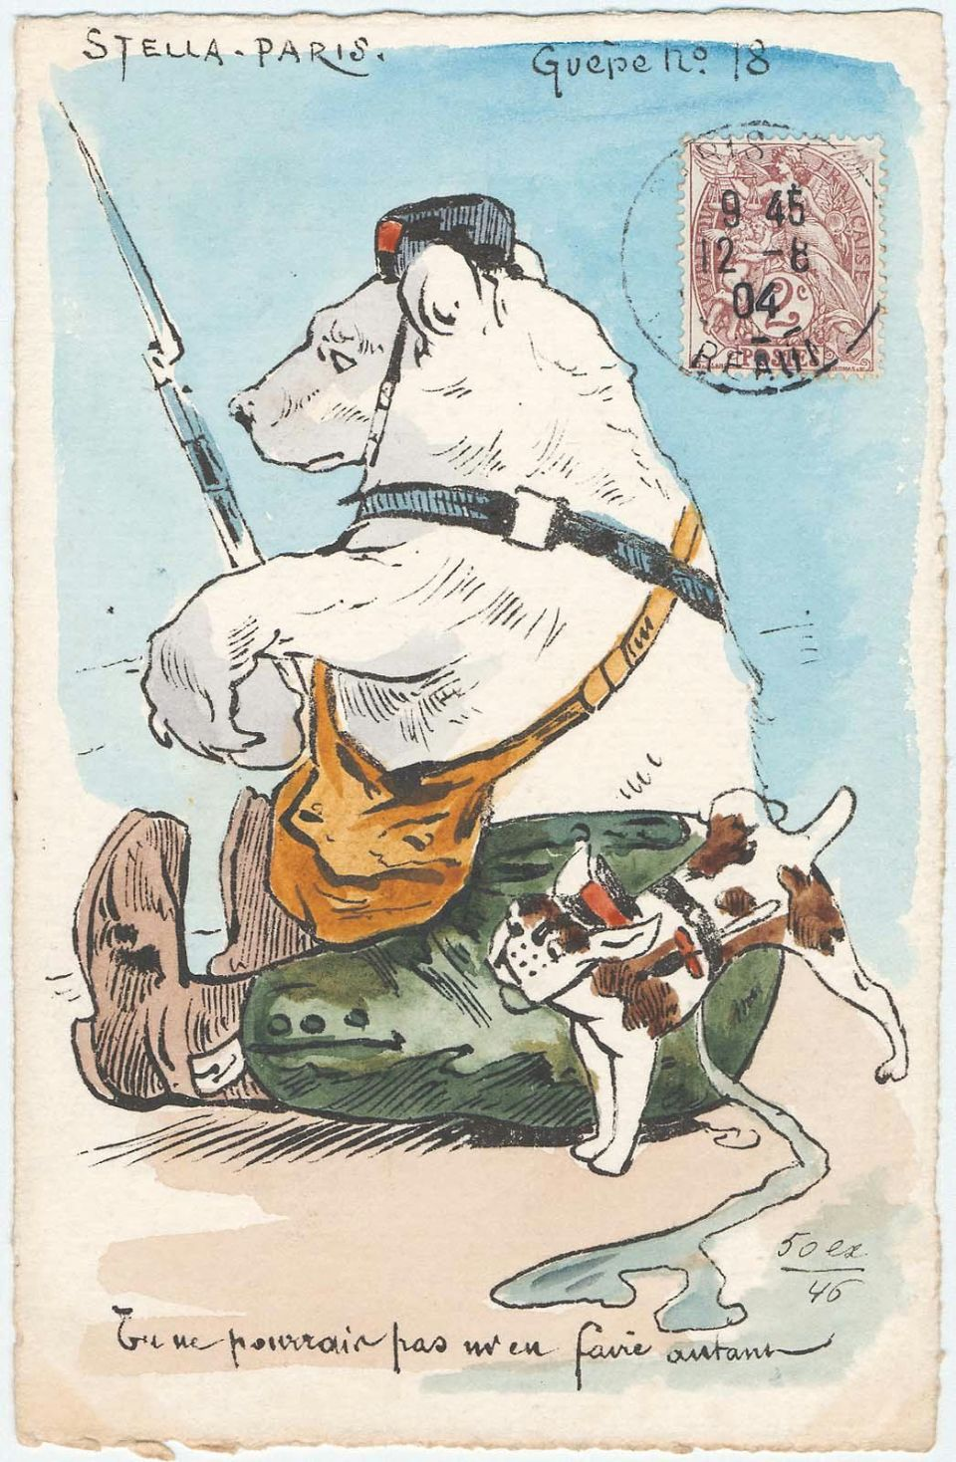
The Sino – Japanese War [1894 – 1895]
The Russo – Japanese War
[1904 – 1905]
[left] Punch Vol 107 (August 1894) prior to the Sino-Japanese War
[right] French Postcard “You Can’t Do Such a Thing to Me” 1904, prior to the Russo-Japanese War

Slide 13
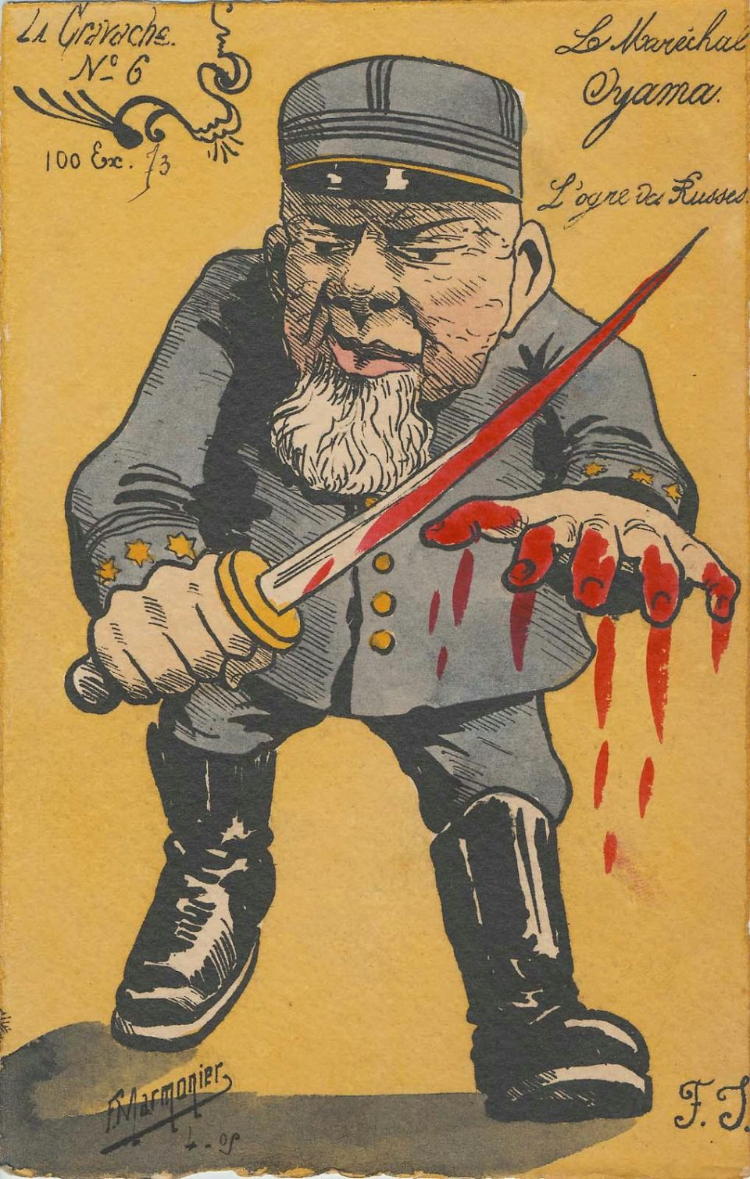
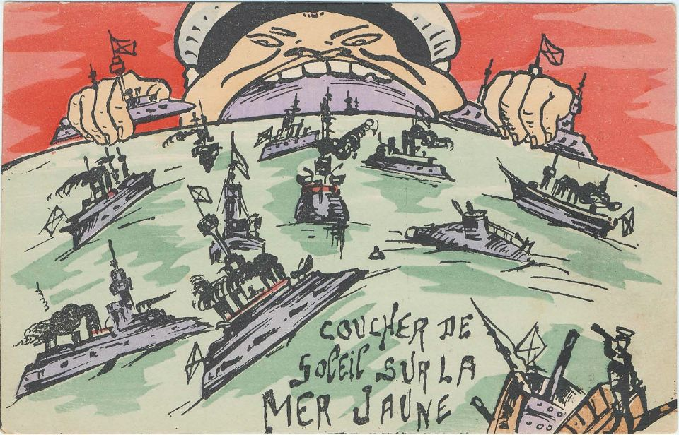
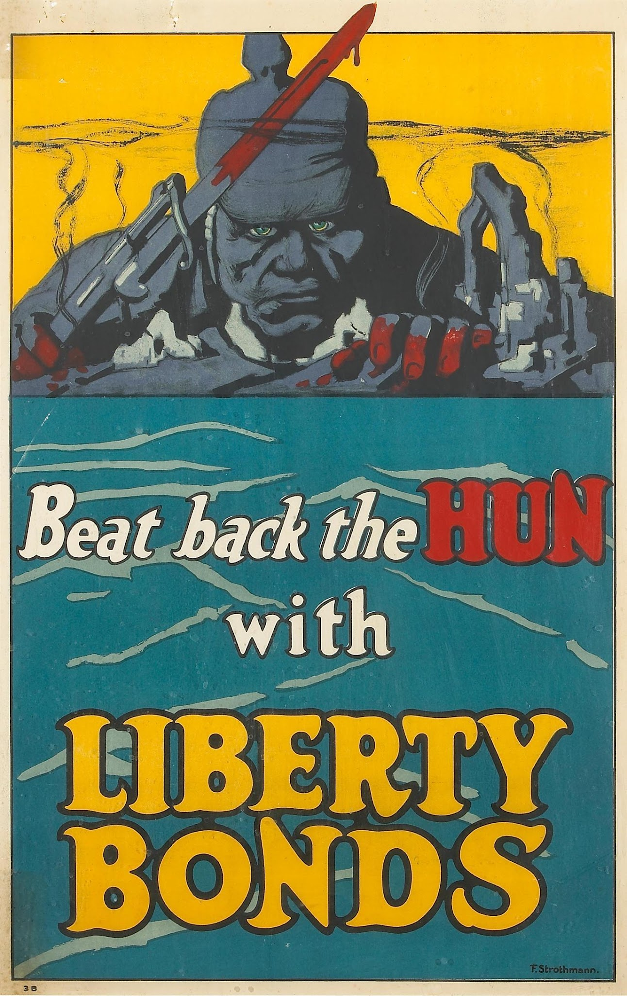
[left] ”Marshal Oyama” [French Postcard, 1905]
[right] “Sunset on the Yellow Sea” [1905]
Foreign reactions to the Russo – Japanese War establish a visual vocabulary of THE YELLOW PERIL
[right] Rederick Strothmann, “Beat Back the Hun with Liberty Bonds,” 1918

Slide 14
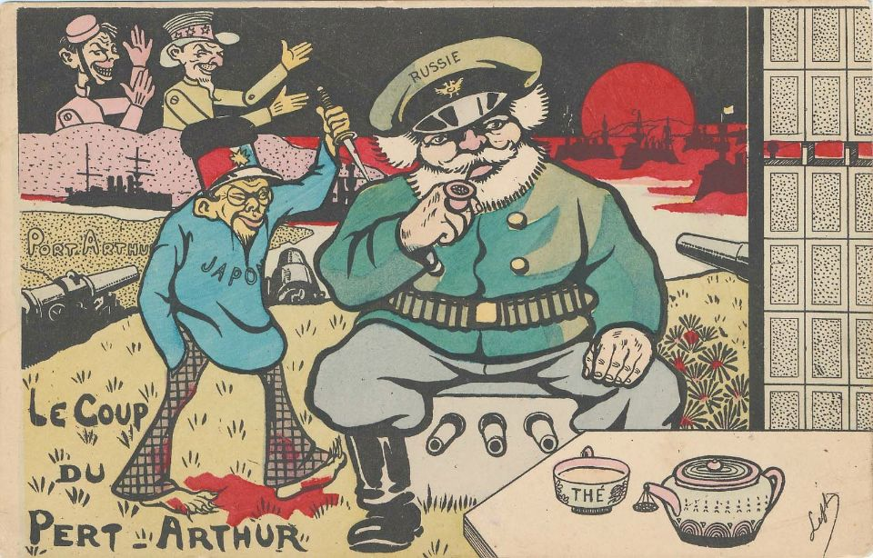
“The Coup at Port Arthur” French Postcard, Russo-Japanese War, 1905

Slide 15
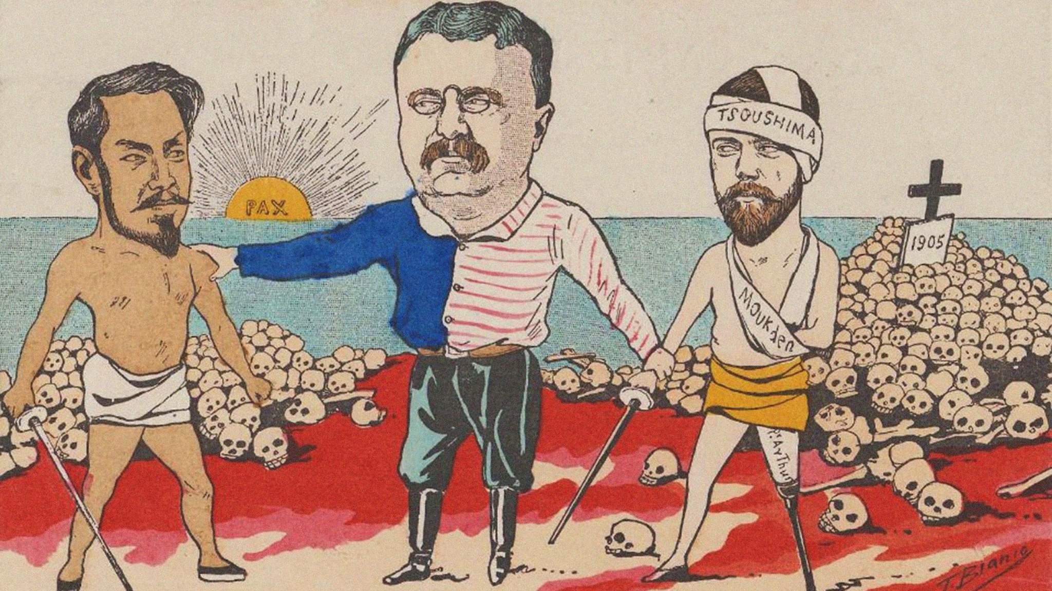
Theodore Roosevelt on the “Threat of Japan”
“But with Japan the case is different. She is a most formidable military power. Her people have peculiar fighting capacity. They are very proud, very warlike, very sensitive, and are influenced by two contradictory feelings; namely, a great self-confidence, both ferocious and conceited, due to their victory over the mighty empire of Russia; and a great touchiness because they would like to be considered as on a full equality with, as one of the brotherhood of, Occidental nations, and have been bitterly humiliated to find that even their allies, the English, and their friends, the Americans, won't admit them to association and citizenship, as they admit the least advanced or most decadent European peoples. Moreover, Japan's population is increasing rapidly and demands an outlet; and the Japanese laborers, small farmers, and petty traders would, if permitted, flock by the hundred thousand into the United States, Canada, and Australia.
[Handwritten P.S.] If possible, the Japanese should be shown, what is the truth, that our keeping them out means not that they are inferior to us - in some ways they are superior - but that they are different; so different that, whatever the future may hold, at present the two races ought not to come together in masses.
Theodore Roosevelt, Letter to Senator Philander Knox, 1909 (Papers of Theodore Roosevelt, LOC)

Slide 16
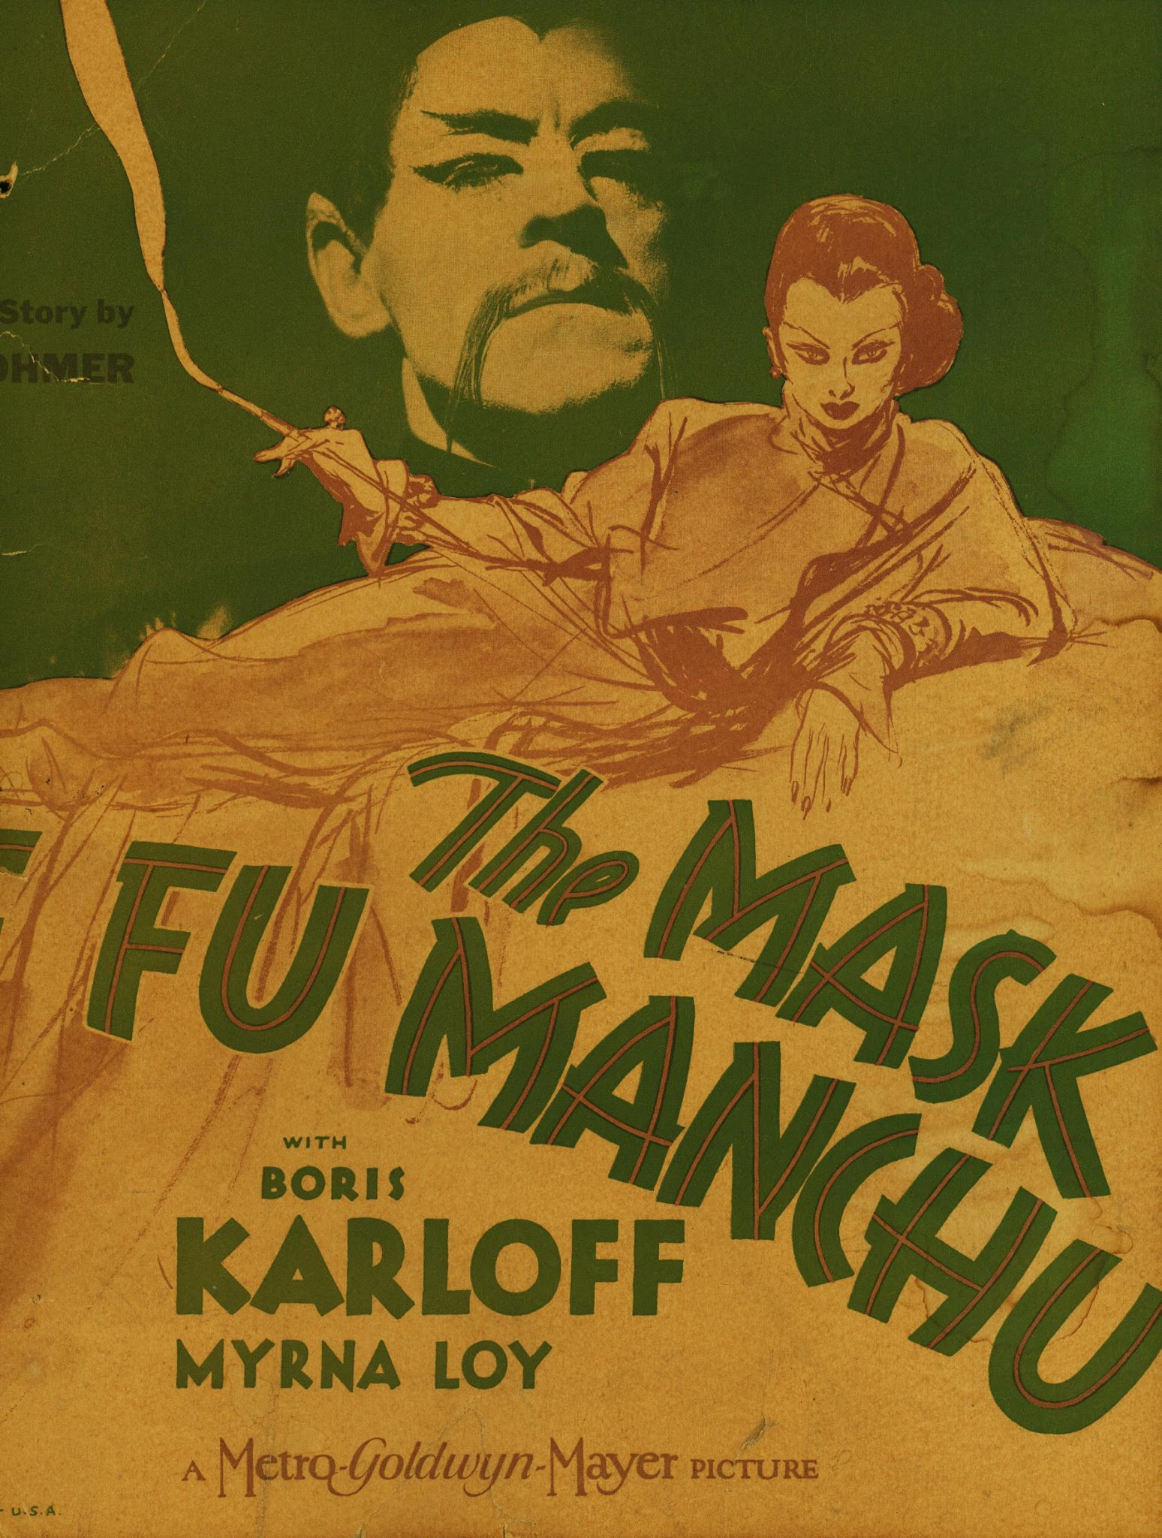
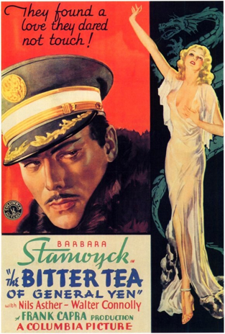
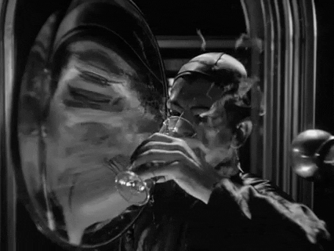
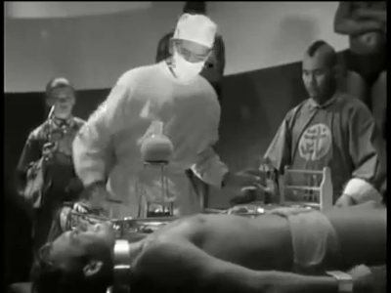
“Yellow Peril” in Popular Culture
Film poster for The Mask of Fu Manchu (1932)
Poster for Frank Capra’s The Bitter Tea of General Yen, 1933

Slide 17
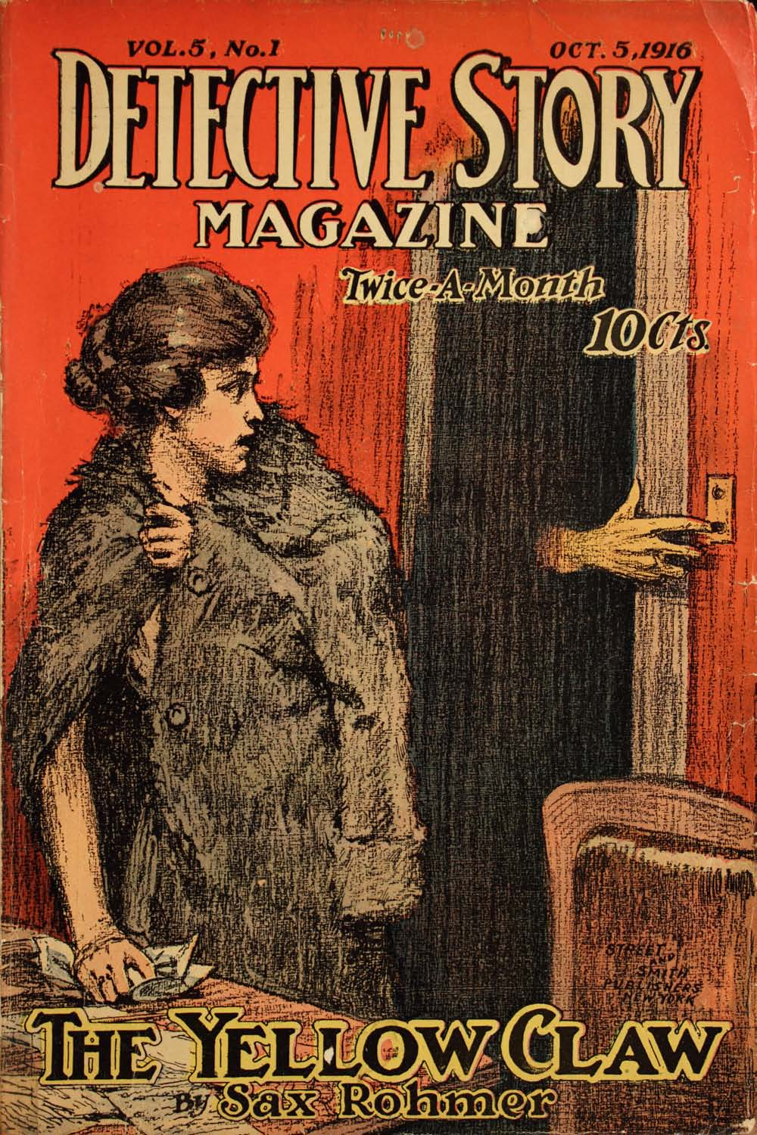
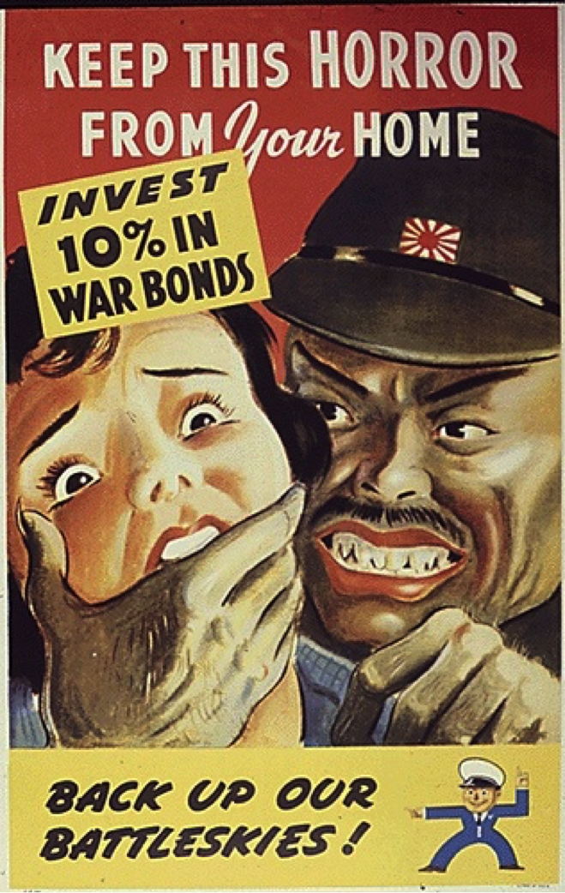
Wartime depictions of the Japanese enemy
DRAW ON and REPRODUCE earlier images of YELLOW PERIL that predate the attack on Pearl Harbor
Sax Rohmer, “The Yellow Claw,” Detective Story 5, no 1 (1916)
Office for Emergency Management War Production Board, c. 1943 [National Archives]

Slide 18
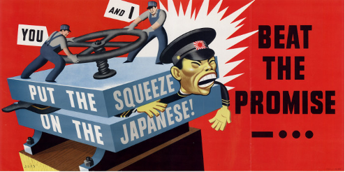
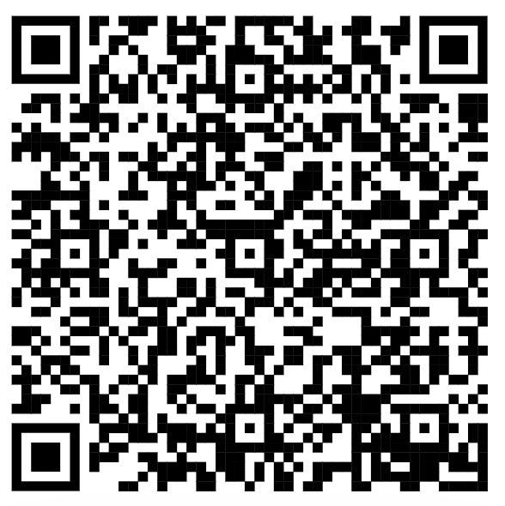
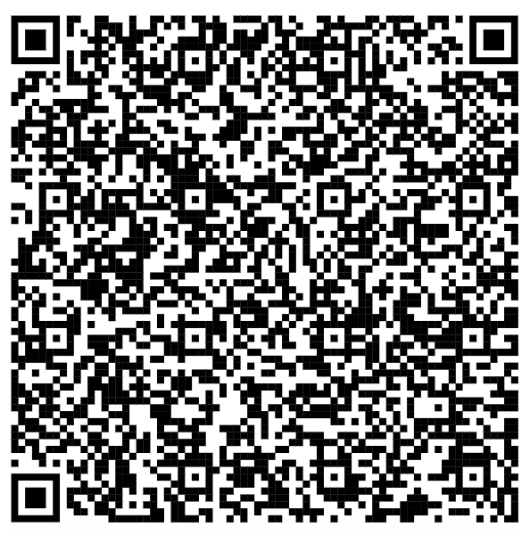
CONSIDER FOR YOUR IMAGES:
What exaggerated or unrealistic features stand out in these images? Do any of them match pre-1941 images?
What is the overall argument of each image?
How might the image increase support for the relocation and incarceration of Japanese Americans?
CLASS ACTIVITY:
Analyzing Anti-Japanese Wartime Imagery
SOURCES:
Yellow Promise, Yellow Peril,
MIT Visualizing Cultures Unit
Anti - Japanese Propaganda,
Hampton Roads Naval Museum

Slide 19
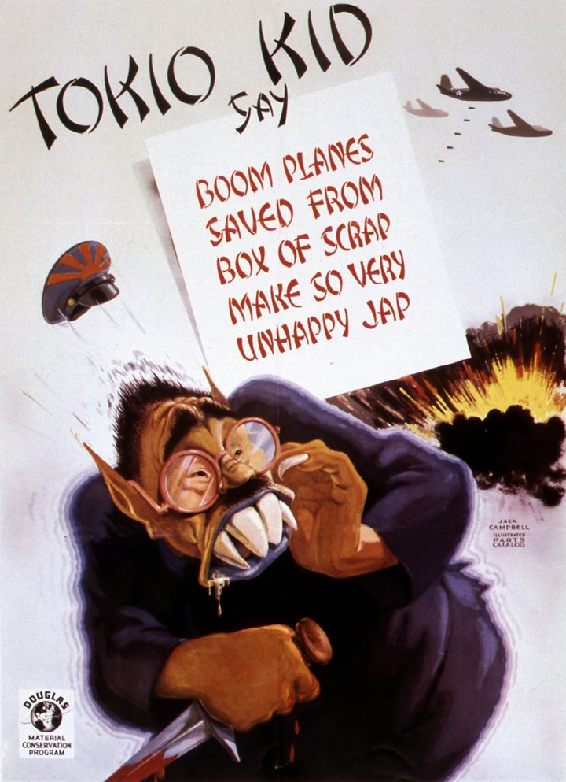
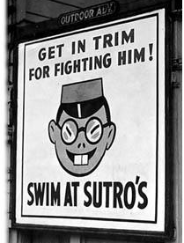
In Popular Culture
[above] Anti-Japanese advertisement at Sutro Baths in San Fransisco, 1942;
[left] material conservation campaign by Douglas Construction, 1943

Slide 20
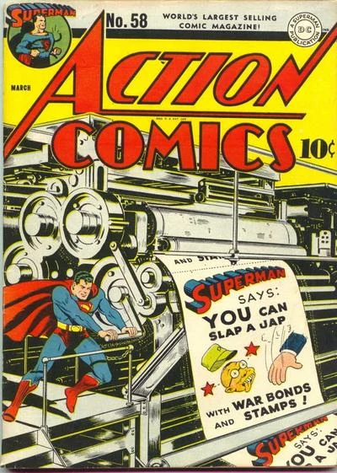
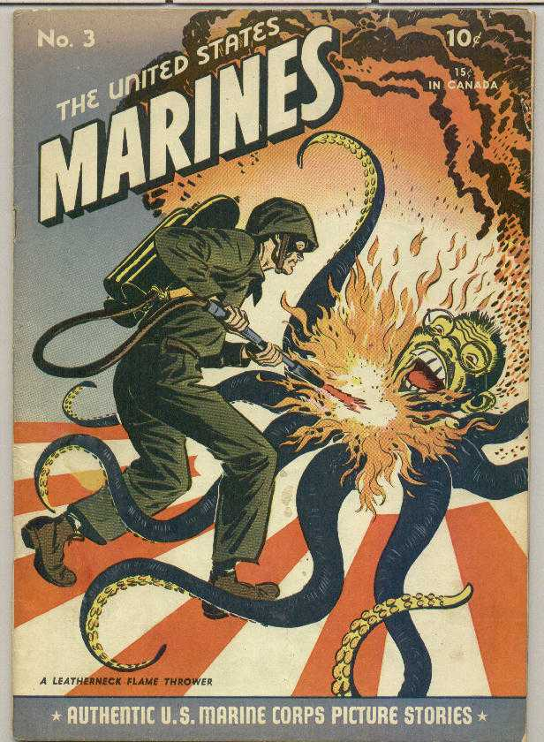
[above] US Marine Corps printed Comic Book; [left] Henry Boltinoff and Bernard Baily, et al., Action Comics #58, March 3, 1943

Slide 21
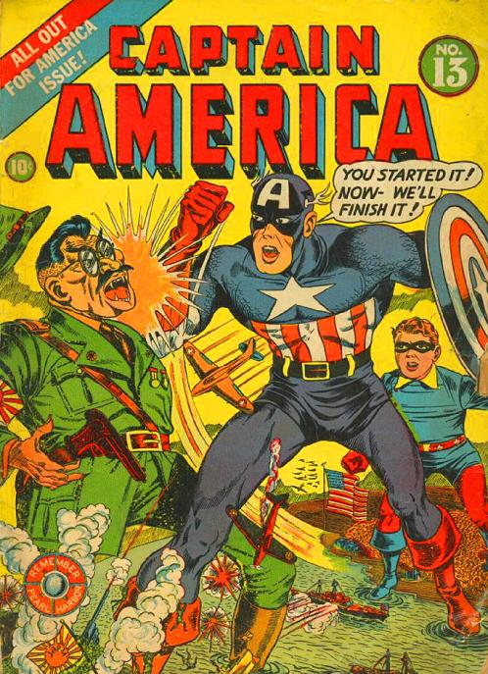
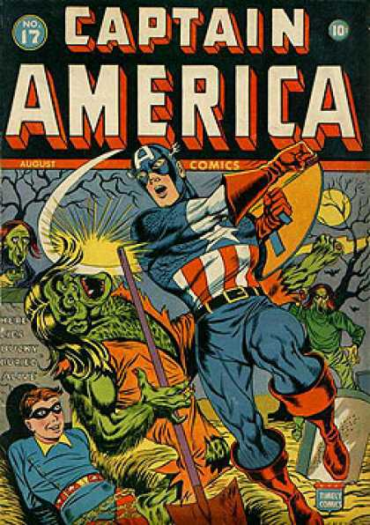
[left] Captain America #13, April 1, 1942; [above] Captain America #17, August 1, 1942

Slide 22
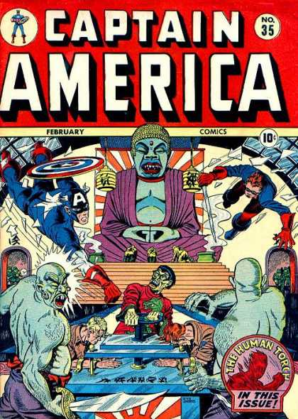
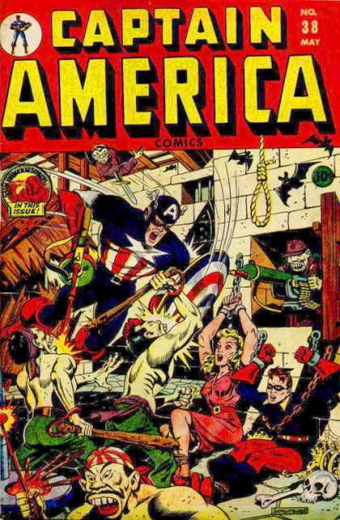

Slide 23
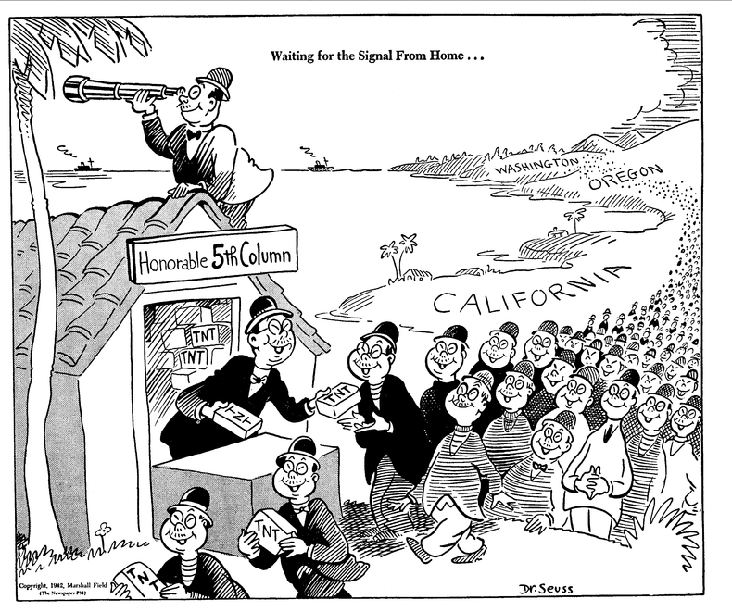
Defining a Japanese Mentality
“Waiting for the Signal from Home” by Theodor “Dr. Seuss” Geisel, February 13, 1943

Slide 24
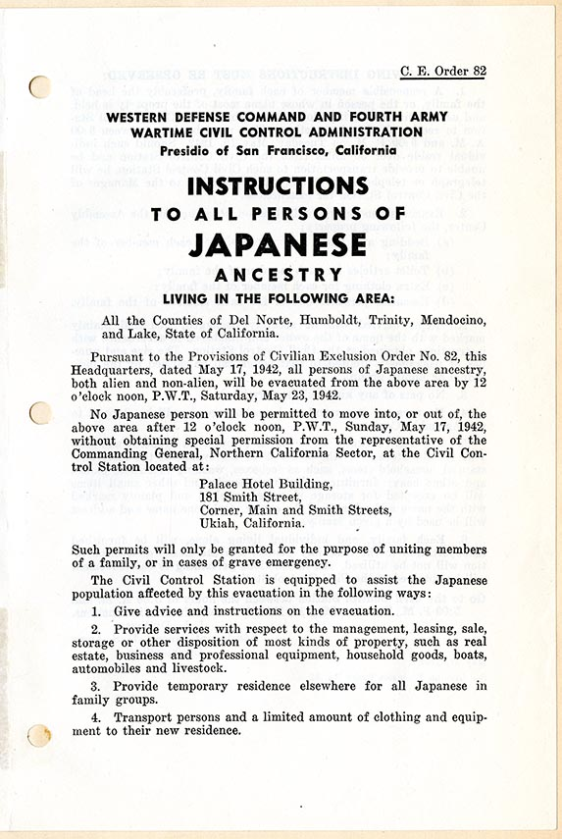
TAKE – HOME: Following the attack on Pearl Harbor, American popular media creates a distinct image of Japan as a uniform, violent, untrustworthy other. But this view draws upon the long history of “Yellow Peril” imagery that accompanied earlier efforts to exclude Japanese immigrants.
[right] “Instructions to All Persons of Japanese Ancestry” Western Defense Command and Fourth Army Wartime Civil Control Administration, 1942

Slide 25


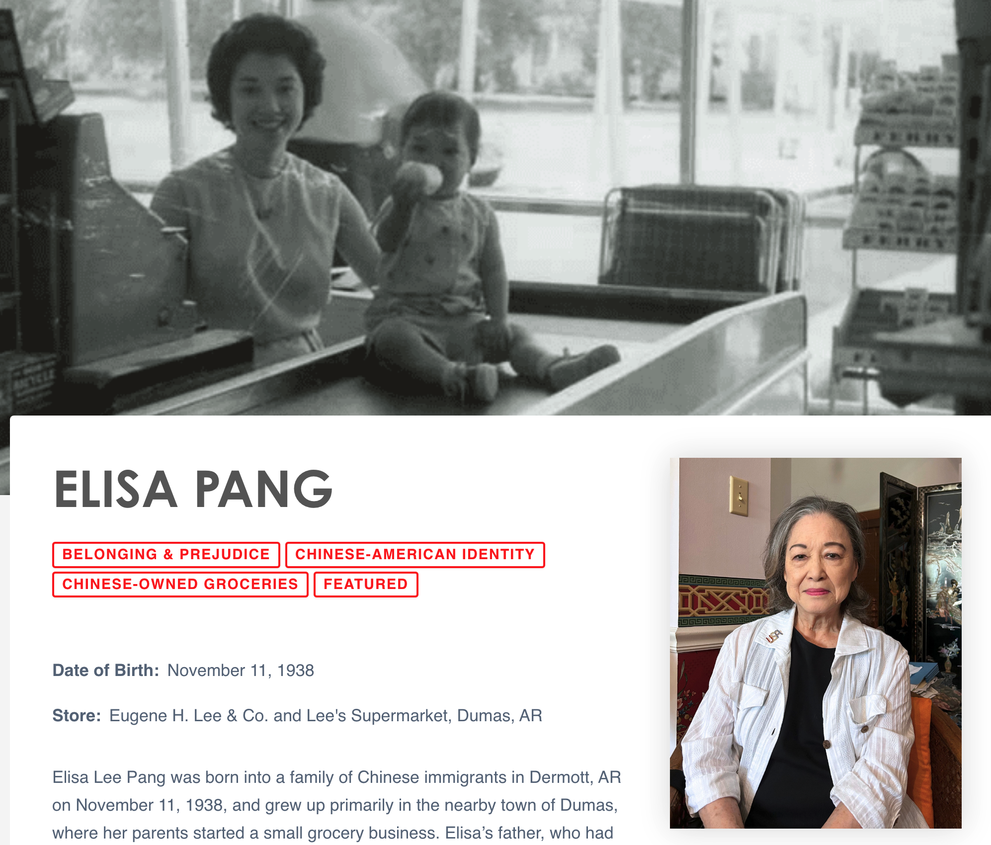
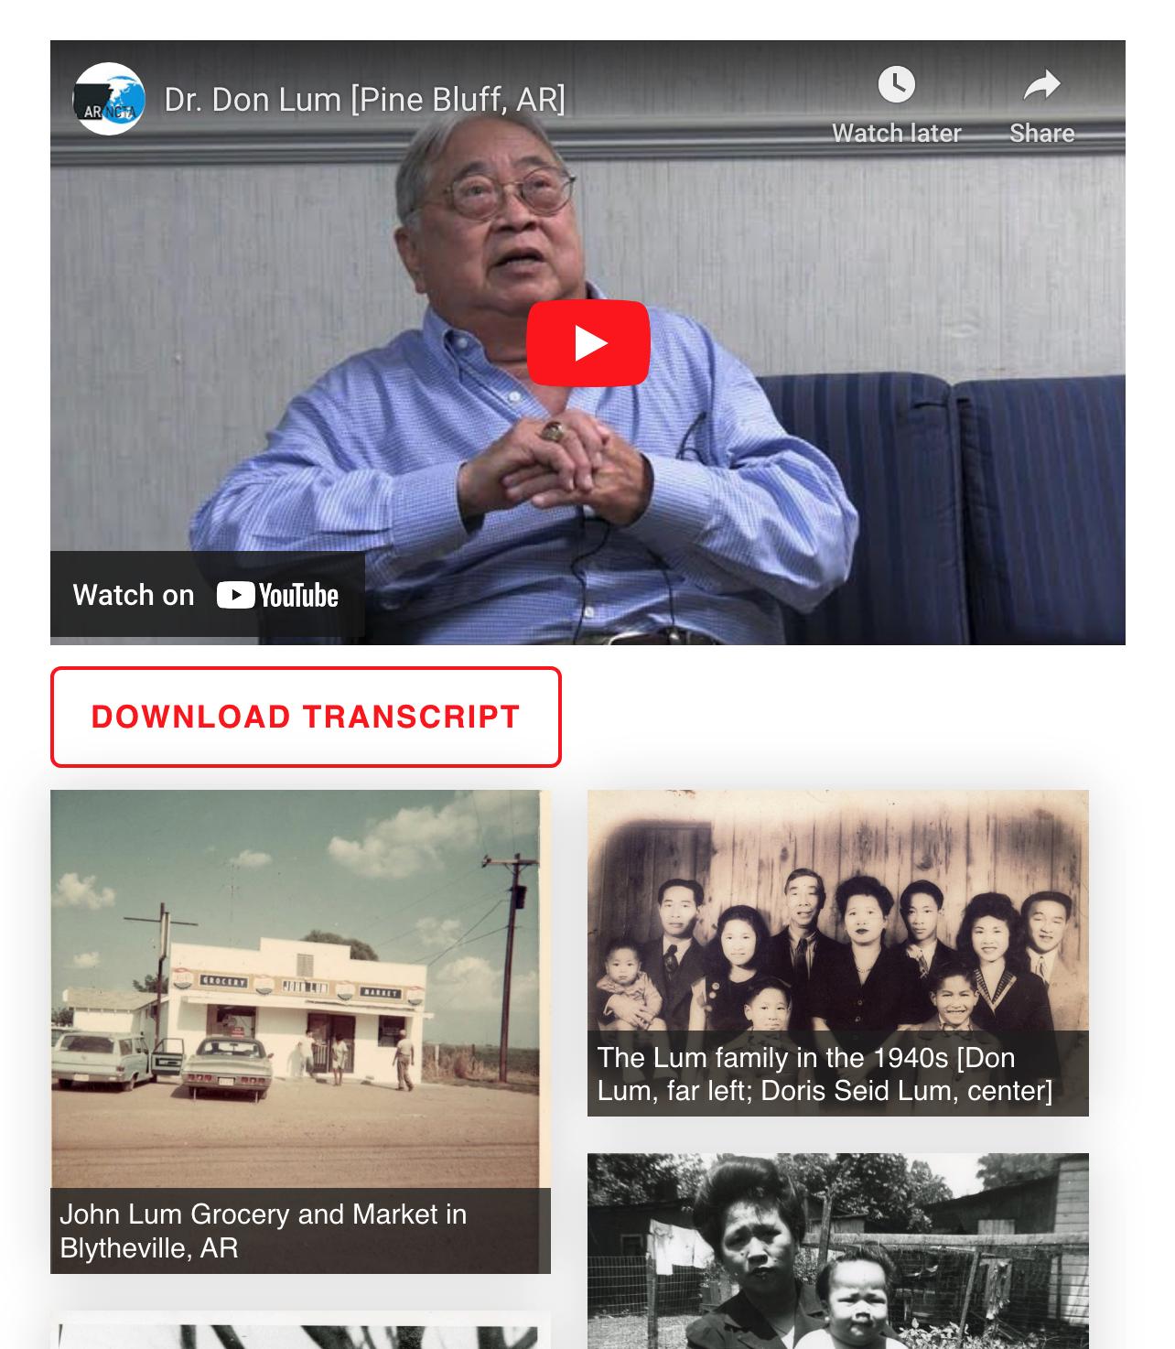
ALSO VISIT…
www.arkansaschineseheritage.org
An online oral history archive containing life-stories, photographs, video interviews, digital exhibits, and teaching resources for high school and undergraduate educators

